Slide 1
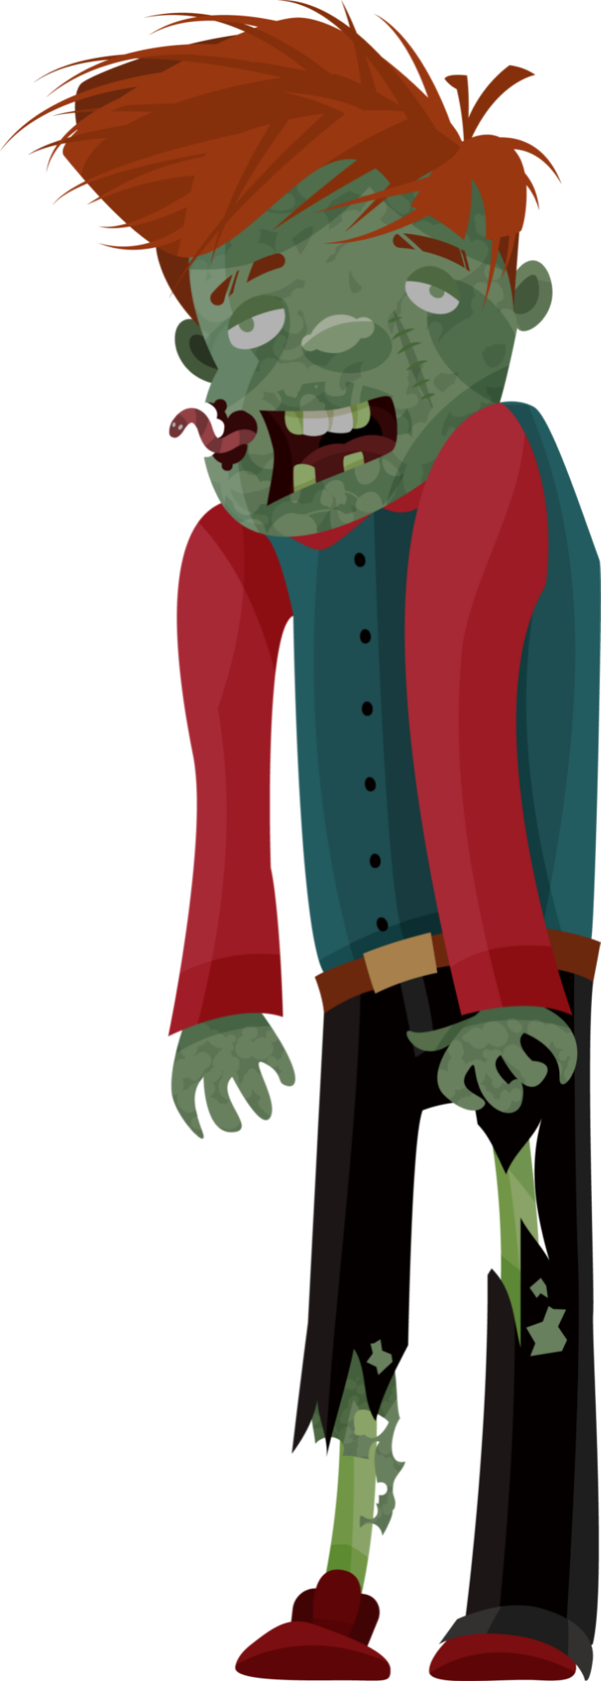
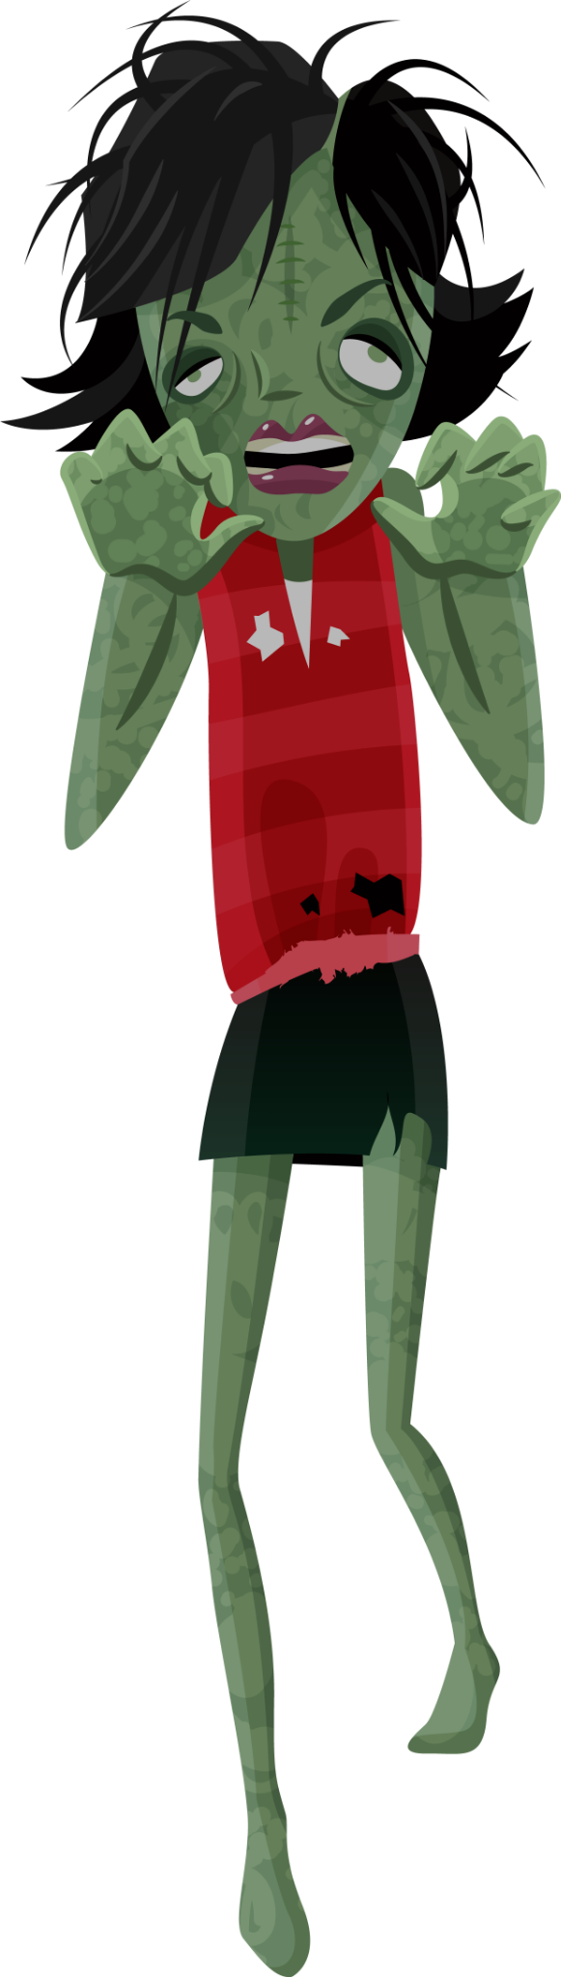
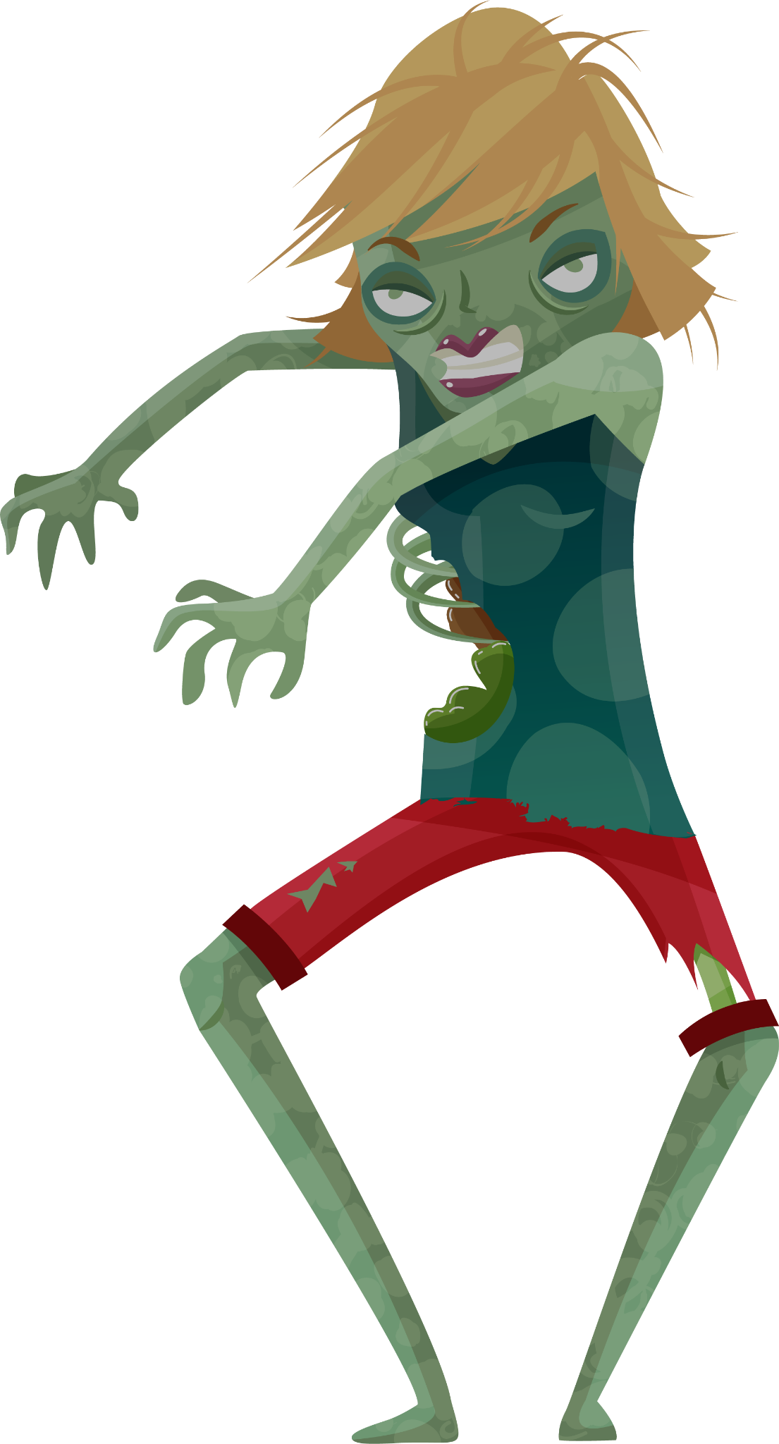
Future of Human In a Zombie Outbreak

Slide 2
Background
In recent years, the zombie has become one of the most popular fictional creatures in novels, movies, and video games. According to popular belief, an unknown source of infection caused the first zombie when a fraudulent corpse emerged from its coffin and rapidly infected the humans who were involved in its burial, as well as some bodies in the cemetery. However, the infected people did not begin to turn into zombies until they killed the first zombie.
In our system description, we aim to develop a model that simulates the spread of zombie infection, then generate potential solutions to help people gain insights into the dynamics of infectious diseases and the effectiveness of various response strategies. The report also provides a brief outline to accomplish these objectives, demonstrating the simulations with different states and concluding with possible results.

Slide 3
Table of Contents
02
01
03
04
05
Derivation of the Model
Qualitative Description
Analysis of the Model
Description of Biological System
Simulation of the Model

Slide 4
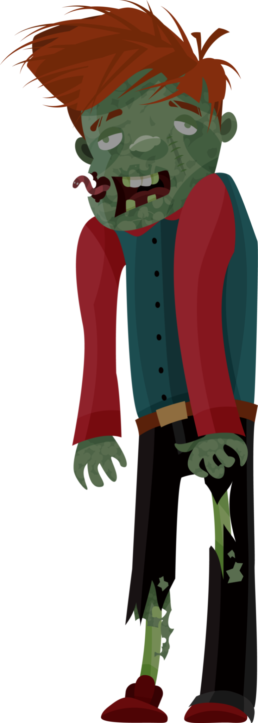
Description of Biological System
01

Slide 5
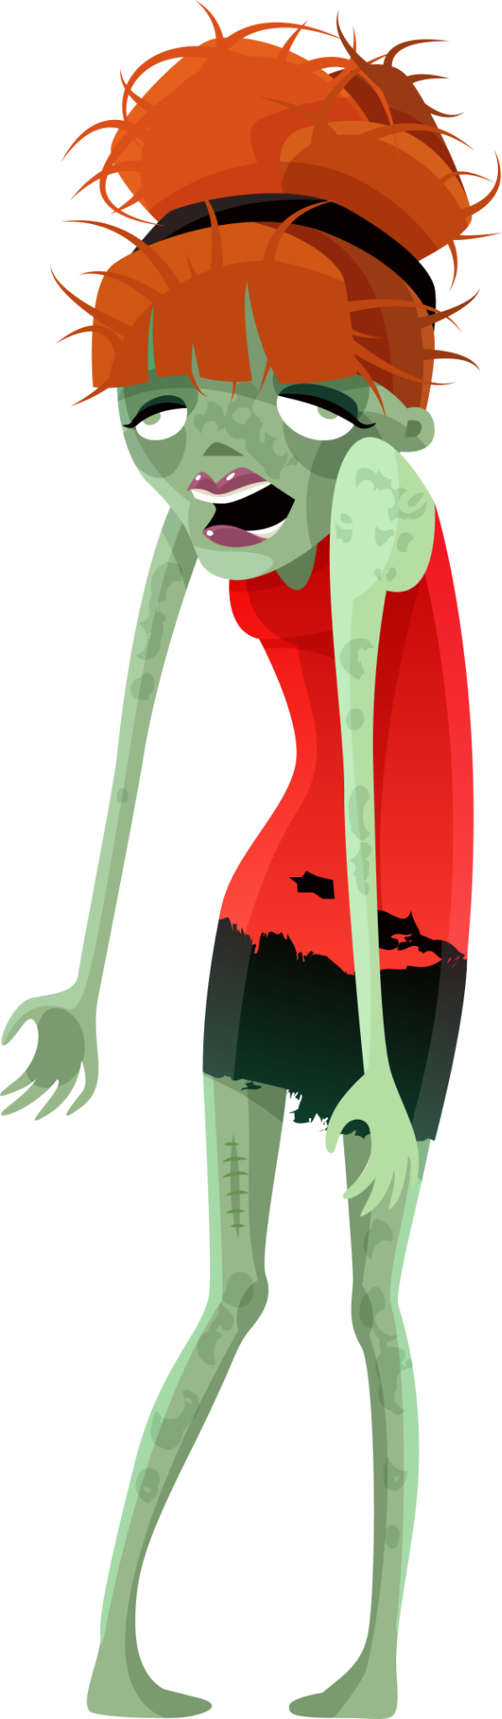
According to popular belief, an unknown source of infection caused the first zombie when a fraudulent corpse emerged from its coffin and rapidly infected the humans who were involved in its burial, as well as some bodies in the cemetery. However, the infected people did not begin to turn into zombies until they killed the first zombie.
Humans can kill zombies to avoid being infected and survive. We assume that:
Only humans will be infected by zombies’ biting.
Zombies only attack humans who have not been infected before.
Killed zombies cannot resurrect forever and they will be permanently removed.
There is no treatment. Infected people will either become zombies or die naturally.

Slide 6
02
Derivation of the Model

Slide 7

The are five state variables and six parameters
State variables:
H (healthy humans)
I (infected humans)
Z (zombies)
R (removed humans)
R* (removed zombies)
Parameters:
π(birth rate of humans)
δ (natural death rate)
β (the probability of humans being bitten by zombies)
α (zombies being killed)
γ (dead humans become zombies)
ρ (the period that an infected person needs to become a real zombie)

Slide 8
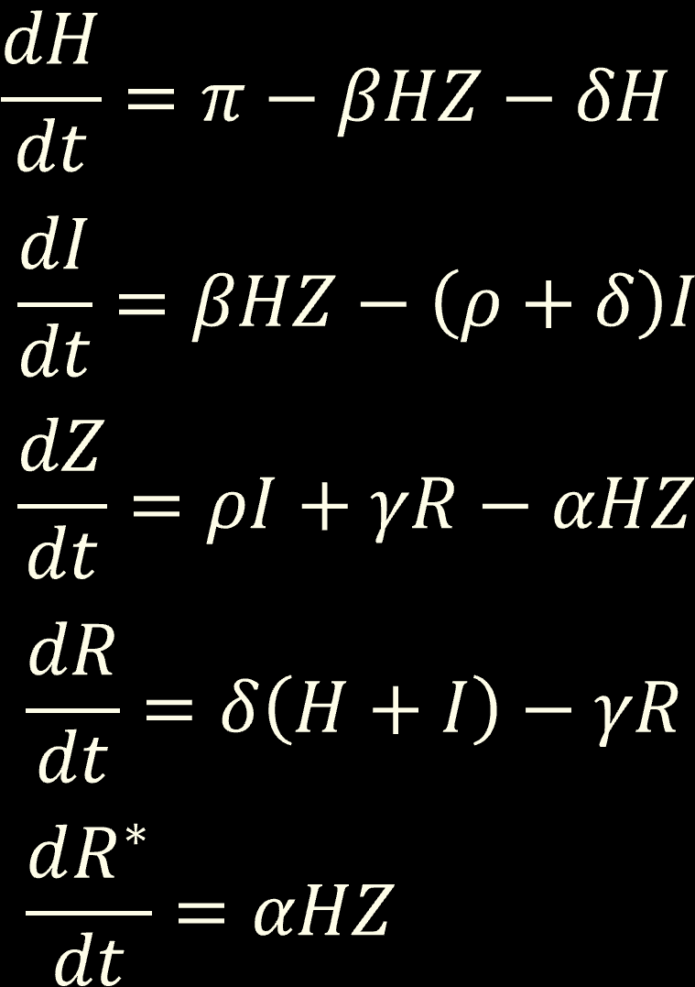
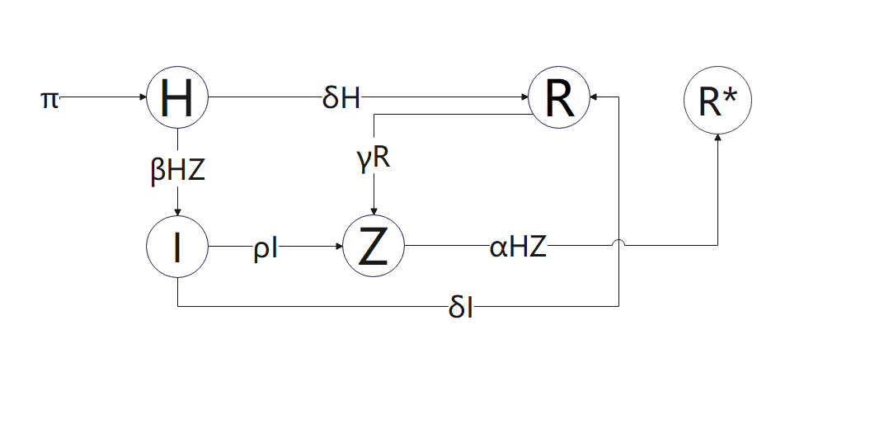
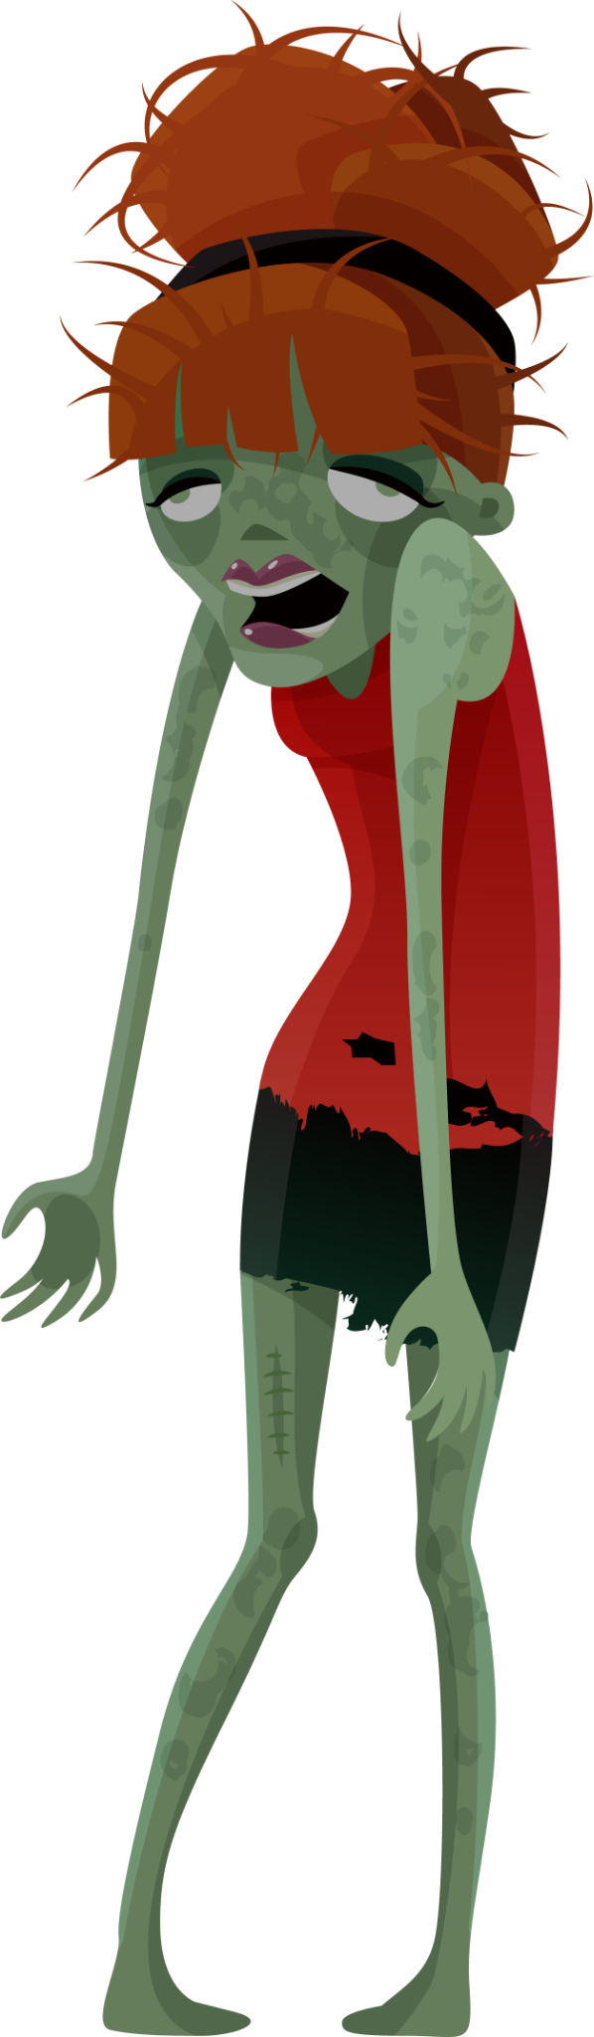


Differential equations for the model

Slide 9
Simulations of the model
03

Slide 10
There are 500 healthy humans, 1infected human, 1 zombie, 100 removed humans, 0 killed zombies.
The birth rate of humans (π) is 0
The natural death rate of humans (δ) is 0
The probability of human being bitten by a zombie(β) is 0.005
The rate of infected humans turning into zombies (ρ) is 1.0
The rate of dead zombies being replaced by new zombies from dead humans (γ) is 0.02
The rate of humans eliminating zombies (α) is 0.001

Slide 11
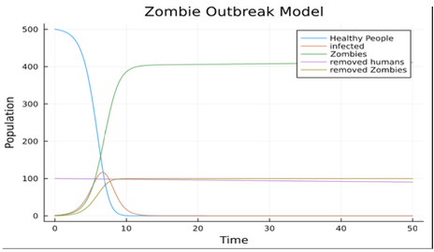
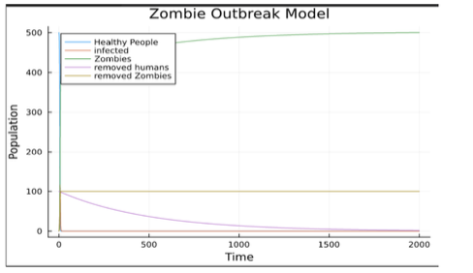
The first model is a classic case in which zombies defeat humans in a short period.
We extend the length of the time axis to 2000 days to wait all removed humans resurrect.

Slide 12
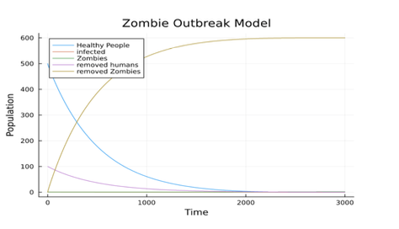
For non-negativity, we set variables as 0:
H′ = π − β(0)Z − δ(0) = π
I′ = βHZ − (ρ + δ)(0) >=0
Z′ = ρI + γR − αH(0) >=0
R′ = δ(H + I) − r(0) >= 0
R*′ = αHZ >= 0
We find that when variables in their corresponding differential equations equal to 0,
slopes are non-negative, including the condition π=δ=0
For boundness, if we add all differential equations together, we could find
N’= H′ + Z′ + I′+R′+ R*’= π or 0 if we consider the natural birth rate or not. Since π is a parameter, the total population is bounded
α = 0.006
Express in formula:
N(0) = H(t) +Z(t) +I(t) +R(t) +R*(t)
N’= H′ + Z′ + I′+R′+ R*’=0

Slide 13
Qualitative Description
04

Slide 14
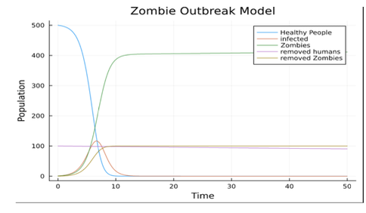
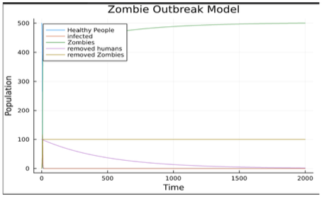
In Figures 1 and 2
After about seven days, lines of zombies and healthy people intersect with infected people reach the maximum.
On the ninth day, humans are extinct.
On about the tenth day, there exists small number of struggling infected people.
On the twelfth day, zombies finally master the world. About thousands of days later, number of zombies will keep constant.

Slide 15
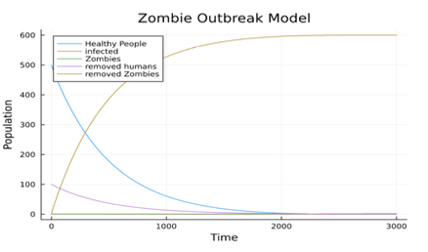
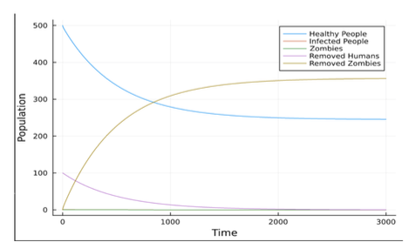
On the 2300th day, humans lose this battle.
In this case, the number of zombies nearly approaches zero.
In this case, the line of zombies keeps zero.
α = 0.007
On the 2000th day, both humans and removed zombies become stable.

Slide 16
Analysis of the Model
05

Slide 17
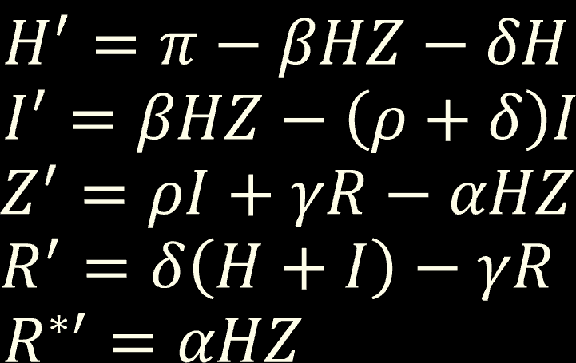
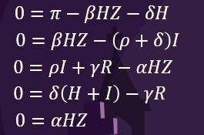
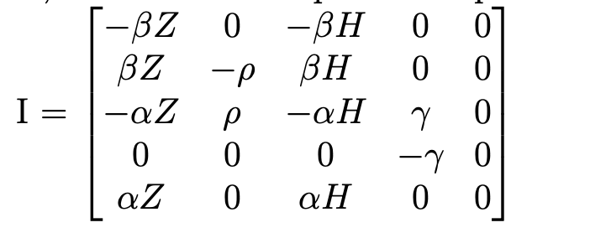
Find equilibrium for the differential equations
Lets’ call this the HIZR model
The model equations are:
Jacobian Matrix
From the last two equations, it’s clear that all state variables are 0 except H or Z, which are two equilibrium points in this model.
In this case, we calculate the Jacobian Matrix and the stability of (N, 0, 0, 0, R*), (0, 0, Z, 0, R*) and (0, 0, 0, 0, R*).
When the equations to zero:
We could get either H=0 or Z=0 from the first equation. Hence, I in the second equation is 0 since ρ is always positive.

Slide 18
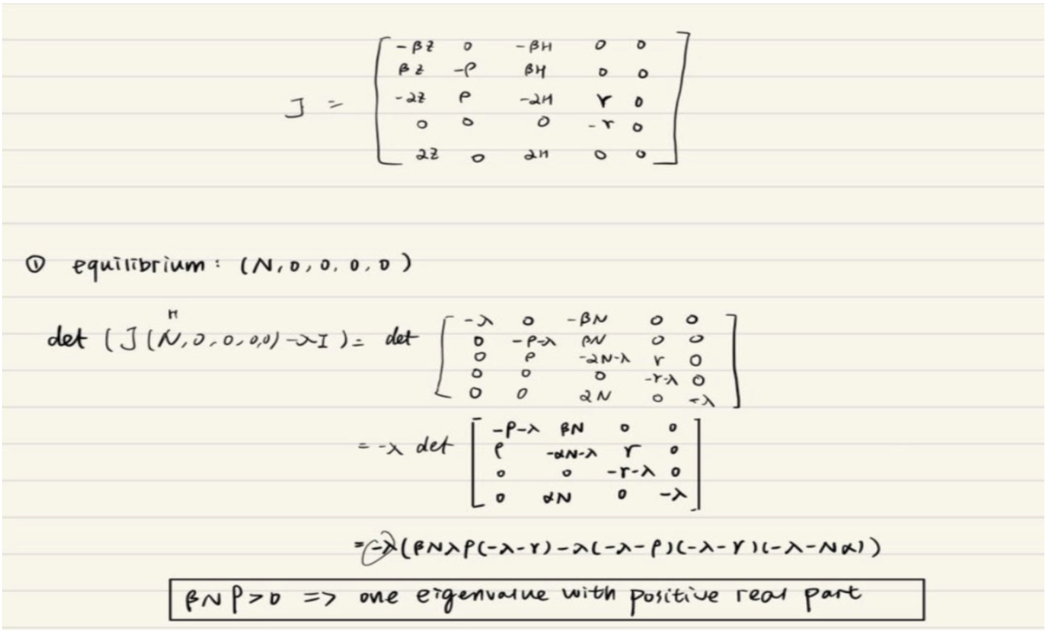
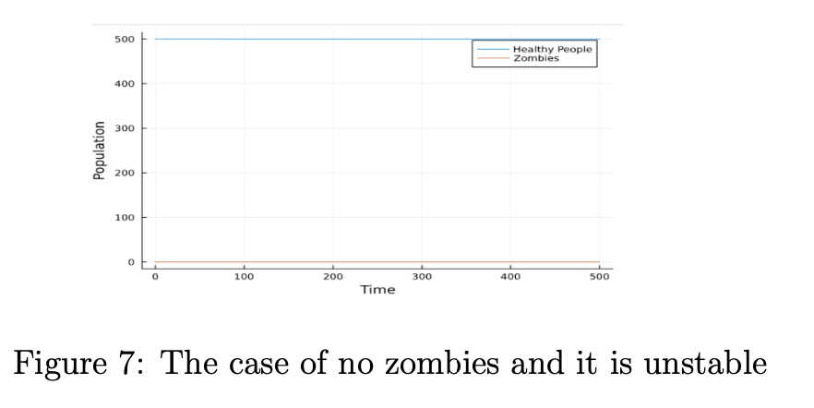
(N,0,0,0,R*)
By Hadamard-Perron theorem:

Slide 19
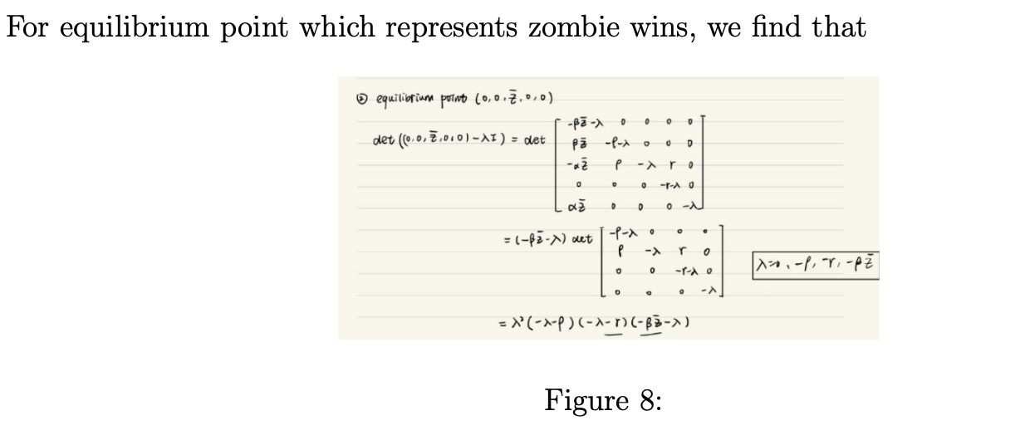
We found there is a value 0 in the eigenvalue, which makes it unable to determine the stability of the eigenvalue.
(0,0,Z,0,R*)

Slide 20
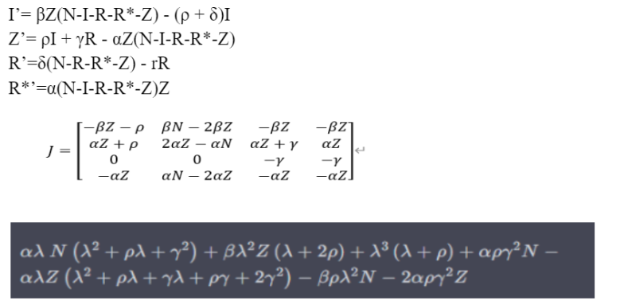
How About (0,0,Z,0,R*) ?
If we ignore the first differential equation and set H=N-I-R-R*-Z, we could get new equations, Jacobian Matrix and determinants as figure shows.
The eigenvalue of J is
[ - 2αZ + αN + βN - 2βZ – γ - ρ
- αZ – βZ - ρ,
- αZ – βZ - ρ,
- αZ – βZ - γ ]
2Z is larger than N because zombie wins with other variables are 0. Since we have all eigenvalues negative, the fixed point is stable when we substitute (0, 0, Z, 0, R*) into the eigenvalue.

Slide 21
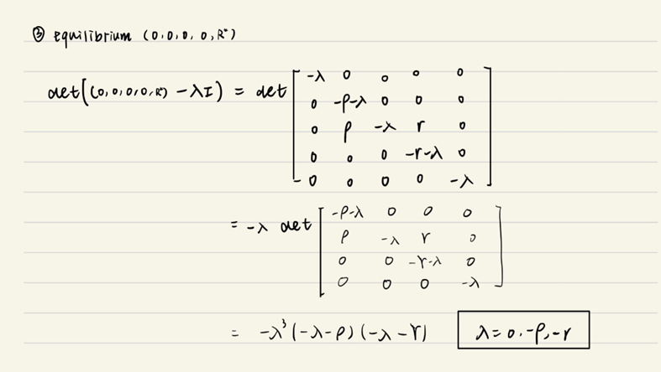
Now Consider (0,0,0,0,R*)
This is a situation where none of the zombies and humans survived.
The eigenvalue contains 0, that is to say, this equilibrium point is a saddle point.

Slide 22
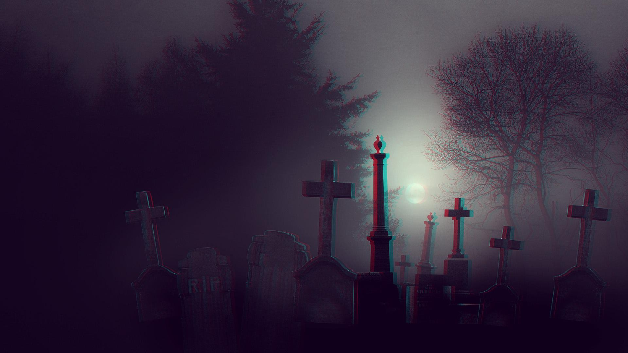
Limitation of the model
- The birth rate of humans (π) is 0 and the natural death rate of humans (δ) is 0, which means it’s not realistic.
- In our model, we suppose that zombies are eternal to live and ignore the carrying capacity of this ecosystem, which simplifies the model but seems unrealistic.
- We did not consider the mutation of zombie virus.
- We have many state variables and parameters, and it’s a little bit hard for calculation.
-Our model is continuous-time model, so we don’t have phase diagram.

Slide 23
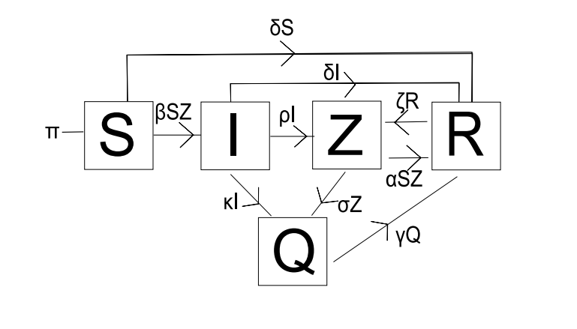
Improvements of the model
-
-
More complex scenario
-> Capacity of Ecosystem
-> Values of State variables and Parameters
-> Influence of Mutation
-> Better supplies
Change model?
Change background?
……

Slide 24

Conclusion
In summary, our analysis and simulation of the zombie outbreak model showed that unless taking aggressive tactics(e.g., heavy weapons), a zombie outbreak can have disastrous con- sequences for humans. However, external factors such as the availability of weapons, medical supplies, and individual behavior can significantly impact the infection rate and overall outcome. Therefore, it is vital to consider these factors and take appropriate action to mitigate the spread of a zombie outbreak.

Slide 25
Thanks for your Patience

